Slide 1


?
YOU KNOW
WHAT IS THE
MOST ALARMING
PROBLEM FACING BANGLADESH TODAY?

Slide 2

In Bangladesh, the doctor-to-population ratio is approximately 1 doctor for every 1,847 people

Slide 3
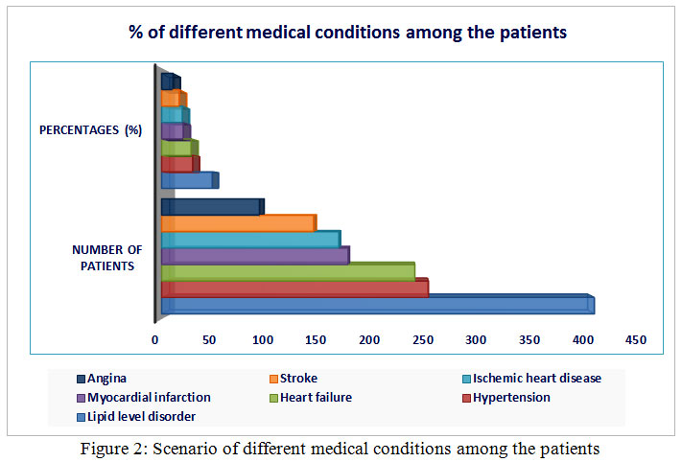
Heart attacks alone caused 17.45% of all deaths in 2022; combined with other heart diseases (~3.7%), cardiovascular issues made up 21.1% of total deaths .and According to the latest WHO data published in 2020 Coronary Heart Disease Deaths in Bangladesh reached 108,528 or 15.16% of total deaths.

Slide 4
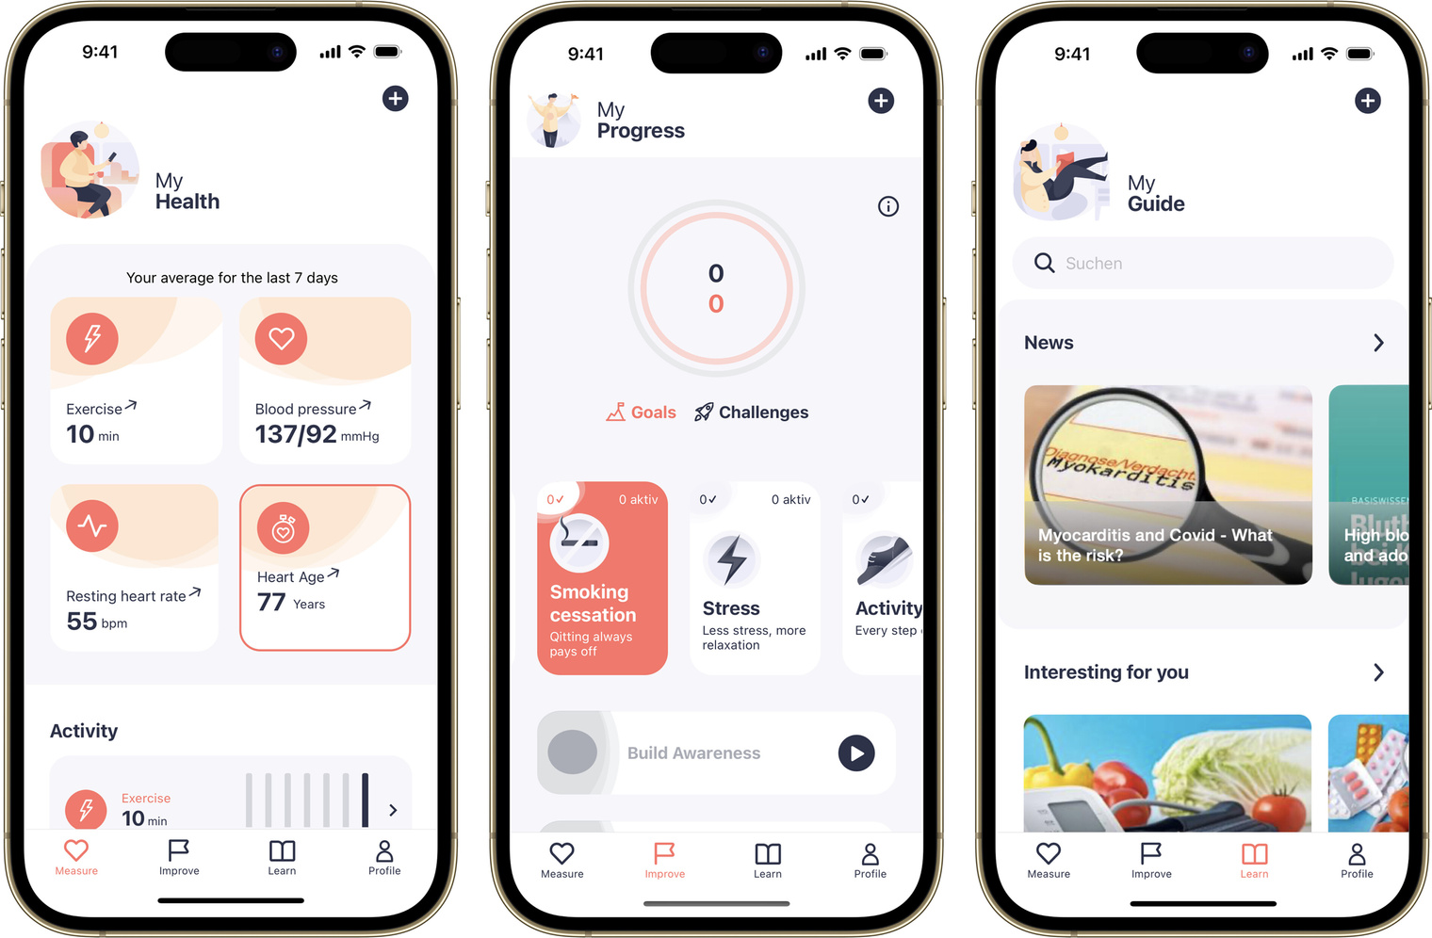




What if ?
Give you an accurate analysis of your heart condition
You had an app that could look at your ecg
Detecting Coronary Artery Diseases and Heart Attack
Warn you before any real danger happens

Slide 5
So You Already Understand What are we going to do?
DETECTING CORONARY ARTERY DISEASES AND
HEART ATTACK THROUGH ECG
MD:Saiful ISlam-2132105642
Istiak Ahmed Moyen-2131580642
S.M Karimul-22126886542
Raiyan Ahmed-2221931042

Slide 6
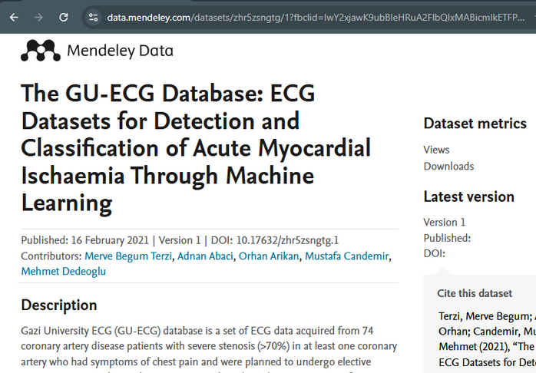
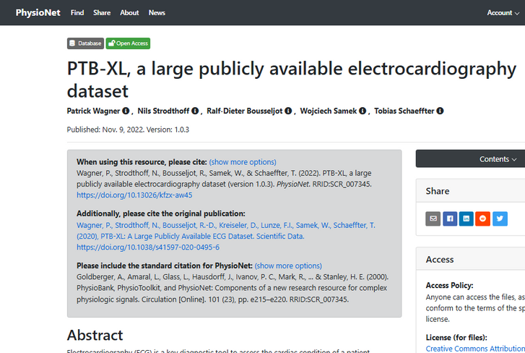
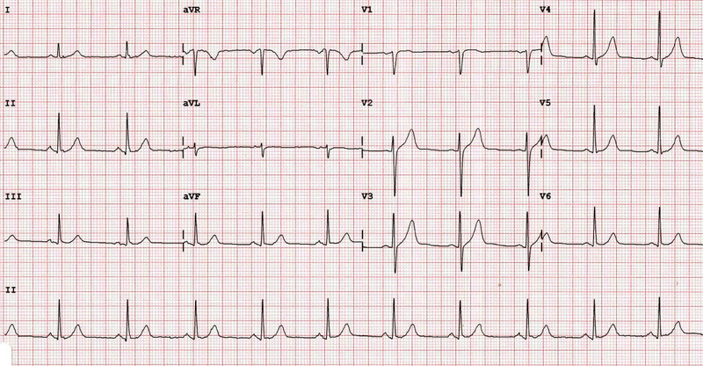
ECG DATASET
PTB-XL:
5469 Myocardial Infarction
9514 Normal Patients
5235 ST/T Change
4898 Conduction Disturbance
2649 Hypertrophy
GU-ECG Database:
74 coronary artery disease, prone to Myocardial Infarction

Slide 7

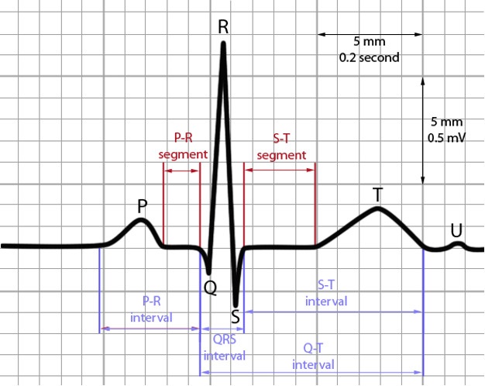

Features
ST Segment Features
ST Level
Measures how much the ST segment is elevated or depressed from the baseline.
Used as a major indicator of heart disease, especially during myocardial infarction.
ST Slope
Angle or incline of the ST segment.
A steep or flat slope can signal ischemia or abnormal conditions.
T wave Features
T Area
Total area under the T wave, calculated using numerical integration.
Changes depending on the heart’s electrical recovery phase.
T Extremum
The highest or lowest point of the T wave.
Helps identify irregularities in the repolarization process.
T Wave Width
Duration of the T wave.
Abnormally wide waves may reflect delayed recovery.
T Wave Symmetry
Whether the wave is evenly shaped or lopsided.
Asymmetry can be a sign of damaged heart tissue.

Slide 8



QRS complex Features
QRS Duration
Time taken for the ventricles to depolarize.
Long durations indicate conduction delays or blocks.
QRS Area
The total power of the QRS complex, calculated from area under the curve.
Useful for detecting ventricular hypertrophy.
QRS Slope
Rate of change (rise/fall) during the QRS complex.
Abrupt or slow slopes help detect abnormal conduction.
R Peak Amplitude
Height of the R wave.
Reflects ventricular muscle strength.
P wave Features
P Wave Duration
Time taken for atrial depolarization.
Longer durations may signal atrial enlargement.
P Amplitude
Height of the P wave.
Represents the strength of atrial contraction.
P-R Segment Level
Baseline level just before ventricular depolarization.
Shifts can indicate atrial ischemia or pericarditis.
Interval
based Features
RR Interval
Time between two successive R peaks.
Used to calculate heart rate and heart rate variability.
PR Interval
Time from the start of the P wave to the start of the QRS complex.
Shows conduction time from atria to ventricles.
QT Interval
Time from the start of the Q wave to the end of the T wave.
Prolonged intervals may indicate arrhythmias.

Slide 9

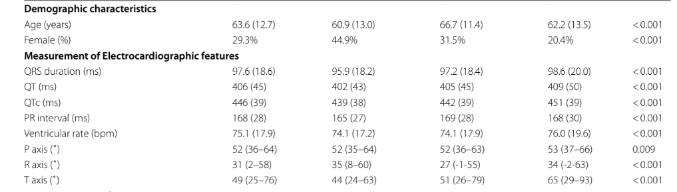
All the features mentioned before such as T wave, P wave, QRS complex, ST segment and Interval-based features are continuous numerical data
A few features like gender and affected by disease will be binary numerical data
Your paragraph text

Slide 10







The Pipleline
Data collection
Data preprosesing
Model selection
Data split
1
2
3
4
Documentation
Deployment
Evaluation
Model training
8
7
6
5
Your paragraph text

Slide 11
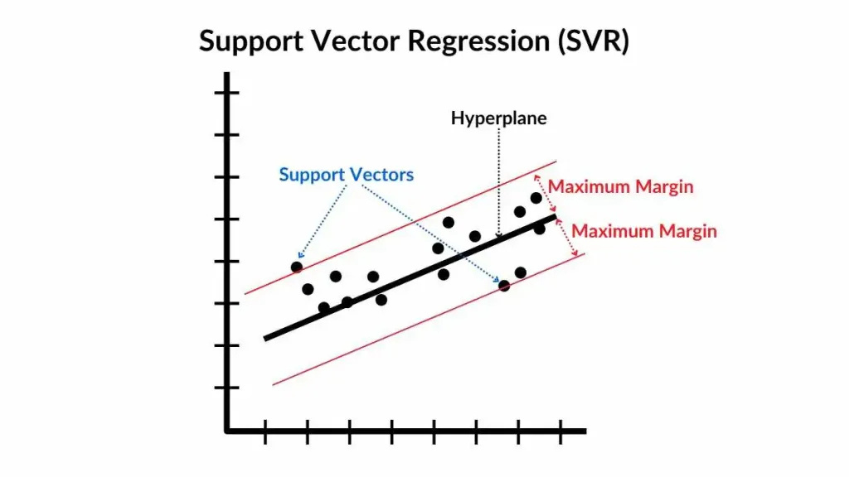
Problem Type Definition
We aim to solve a classification problem with the help of SVM (support vector machine algorithm) using supervised learning.

Slide 12
Overview of the Software
Frontend
(takes input ecg)
Backend
(extracts the ecg features to pass to the model and returns text generated by LLM)
Trained
ML-model
(processes features and generates a result)
LLM model
(generates text based on the result and gives context)

Slide 13
Technology Stack
Data collection: Python
Data processing: pandas,Numpy
Model Training: SciKit-Learn, TensorFlow
Backend: python, Dart
Frontend: Flutter
Database: SQLite
Deployment:AAWS

Slide 14
Gantt chart
Objectives/Terms | Week1 | Week2 | Week3 | week4 | Week5 | week6 | Week7 | Week8 | Week9 | week10
Data collection
EDA & Preprocessing
pipeline setup and model selection
Running Model
Result Evalution
Finetune Model
Deployment
Writting Paper

Slide 15
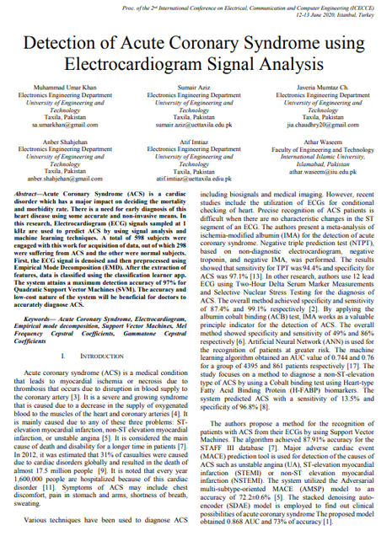
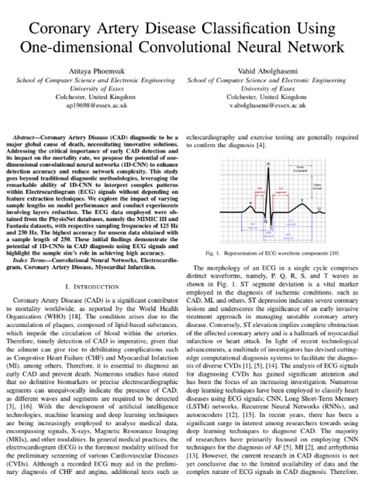
Inspiration
M. U. Khan, S. Aziz, J. M. Ch., A. Shahjehan, A. Imtiaz and A. Waseem, "Detection of Acute Coronary Syndrome using Electrocardiogram Signal Analysis," 2020 International Conference on Electrical, Communication, and Computer Engineering (ICECCE), Istanbul, Turkey, 2020, pp. 1-6, doi: 10.1109/ICECCE49384.2020.9179337.
Phoemsuk, Atitaya & Abolghasemi, Vahid. (2024). Coronary Artery Disease Classification Using One-dimensional Convolutional Neural Network. 10.48550/arXiv.2406.16895.

Slide 16
What makes our app special?
Edge Computing
Explainable AI usage
Helps the user understand their heart condition

Slide 17
THANK YOU!

